Slide 1
Word
Lesson One Notes
Drennan

Slide 2
Word Application
MS Word 2013 is a type of Word Processor
Word Processing software is designed primarily for two purposes
To edit text
To format text

Slide 3
Microsoft Word 2013
How to start Microsoft Word 2013
Click the Word Desktop Icon
Click Start/Programs/Microsoft Office/Microsoft Word 2013
Click Start/find Word in the most recently used application list and click
Browse your file system and double click a Word document
Right click on a word document and select Open

Slide 4
First Screen
To the left will be Recent documents opened
At right will be Blank Document for starting a new document

Slide 5
Quick Access Menu and Title Bar
1
2
3
The Title Bar rests on top of the application
It is the first bar on the top of the document window
It can be divided into three sections:
The Quick Access Menu
The Title of the document and application
The minimize, restore, and close icons

Slide 6
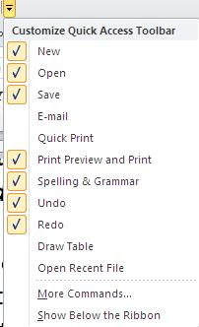
Quick Access Menu
The Quick Access Menu is designed to hold commands used most often
The Quick Access Menu can be customized by clicking the drop-down arrow on the right side of the menu and selecting which commands to display or hide

Slide 7
Tabs (1) and Ribbons (2)
1
2
Tabs were formally called Menu items. They are displayed below the title bar.
There are Nine (9) Tabs by default in Word.
Each tab (except for File) displays its own Ribbon
A Ribbon is a line of icons that are organized into groups with similar commands.
The Tab displayed above is the Home tab, with six (6) different groups.

Slide 8
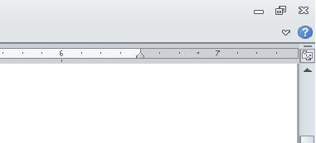
Hiding Ribbons
Users who would prefer to hide the ribbon have three options:
Click the white arrow on the right side of the ribbon
Double-click the ribbon
Right-click the ribbon and select minimize the ribbon
Before Click
Clicking the white arrow hides the ribbon.
After Click

Slide 9
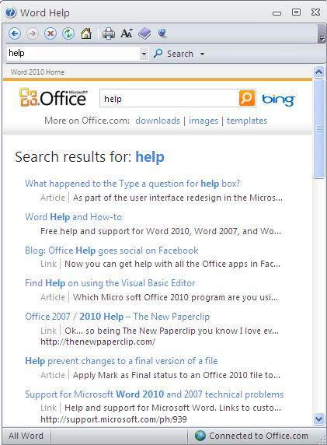
The Help Button
Clicking the blue question mark underneath the close icon on the upper left part of the ribbon activates the Help feature.
Users can type in a feature they would like to know more about and Word will search the Online Help options for information about the feature.

Slide 10
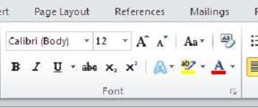
Groups
Each Ribbon is divided into categories of similar commands called Groups
The Home Ribbon has five groups:
Clipboard, Font, Paragraph, Styles, and Editing Groups
On the bottom-right of each group is a black arrow called the Group Launcher
Group Launcher

Slide 11
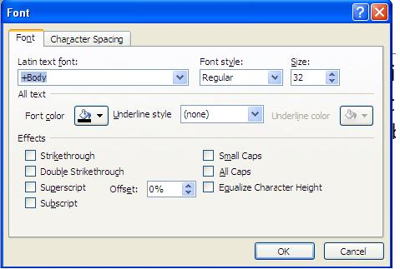
Dialog Boxes
The Group Launcher activates a dialog box that gives the user more options than those displayed in the Group on the Ribbon.
For instance, here is the Font Dialog Box. If compared to the Font Group on the Home Ribbon, there are more options available.

Slide 12
Unavailable Commands
Commands on the ribbon that are displayed in gray are not available to the user.

Slide 13
The Ruler Bar
1
2
The Ruler Bar is displayed above in the red rectangle.
To view the Ruler Bar click on the View Tab and checkmark the Ruler option in the Show Group.
Rulers also displays the location of indentations (1) and tabs(2).

Slide 14
Scroll Bars
The scroll bars are located on the right and bottom of the MS Word screen.
Scroll bars allow a user to navigate quickly through a document.
The vertical scroll bar allows the user to scroll up or down in a long document.
The horizontal scroll bar allows a user to move horizontally through a wide document.

Slide 15
The Status Bar
1
2
3
The Status Bar is located at the bottom of the MS Word window.
The status bar has information about the document on the left side, including the number of typed pages, and the amount of words in the document (1).
On the right side of the status bar is Views Options (2) and the Zoom Slider (3).

Slide 16
View Available in Views Options
Print Layout View—Shows you what the document will look like when printed
Full Screen Reading View—Makes it easy to read and comment on documents on your screen
Web Layout View—Allows the user to see what their document would look like if posted online as a web page
Outline View—Shows you what your document looks like as an outline with the paragraph formatting defining the levels of the outline
Draft View—Makes it as easy as possible to enter and edit text into your document

Slide 17
The Zoom Slider
The Zoom Slider allows the user to change the view settings in MS Word.
The minus sign decreases Zoom
The plus sign increases Zoom

Slide 18
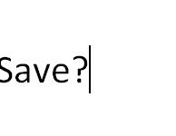
The Cursor
The cursor is typically displayed as a flashing vertical line
It indicates where text will appear when it is typed into the document
When the user types, text will be placed directly behind the cursor
Be Default, the user inserts text between already typed text.

Slide 19
Word Wrap
When keying text in MS Word, the user does not need to worry about hitting the enter key on the keyboard when running out of space on a line of text
Word automatically moves to a new line of text
This feature is called Word Wrap

Slide 20
Enter Key
The Enter key is only pressed when the user wants to enter a new paragraph of text
Hitting the Enter key on the keyboard will insert a new line into a document

Slide 21
Hyphenation
Sometimes MS Word hyphenates a word at the end of a line of text when using the Word Wrap feature.
This feature can be turned off by the user.

Slide 22
The Undo Command
One of the most useful commands to the user is the Undo command.
It is located on the Quick Access Menu Bar.
The Undo command will take the last command and erase its effects.
For instance, if a user accidently deletes a paragraph of text, clicking the undo button will restore the deleted text.

Slide 23
Delete and Backspace
Besides the undo button, there are two buttons located on the keyboard that help the user erase errors when typing, Delete and Backspace.
Delete erases characters to the right of the cursor
Backspace erases characters to the left of the cursor.

Slide 24
Delete and Backspace
Delete
Backspace
Delete will erase text in front of the cursor
Backspace will erase text behind the cursor

Slide 25
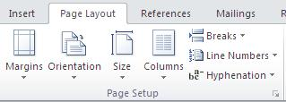
Margins
Margins can be changed by accessing the Page Setup Group from the Home Tab.
The default margin settings for MS Word is one inch for top, bottom, left, and right margins.

Slide 26
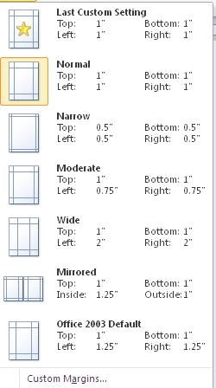
Margins
There are several predefined settings for margins including:
Narrow—one-half inch
Wide—one inch top and bottom and two inches on each side
Mirrored—used when a document is going to be hole-punched or bound

Slide 27
Point and Click
Point and Click allows the user to change the cursor position by using the mouse.
Wherever the user double-clicks the document, the cursor appears, ready to input text where the user has clicked.
There are some locations in the document where the Point and Click feature is unavailable.

Slide 28
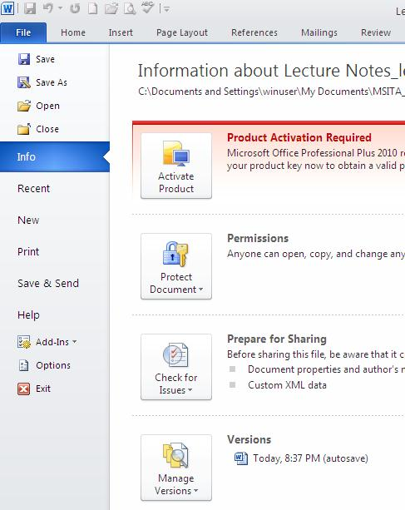
Saving a File
There are two places from which a user can save a file:
The Quick Access Menu
The File Tab, from the
Backstage

Slide 29
Saving a File
When saving a file for the first time, a user can click
File
Save As
Even if the user accidentally clicks the Save button the first time the document is saved, MS Word will automatically revert to Save As and the Save As dialog box appears.

Slide 30
Naming a File
When naming a file, it is important to give the file a descriptive name
Also, users should not include unaccepted characters in the name of their file including:
* The star, which indicates a wild card
? The questions mark, which indicates a query request
: The colon, which indicates a drive

Slide 31
Types of File Formats
The Save As options allows the user to save the document in a different file format.
The Default file format for MS Word 2013 is the MS Word file format.
The extension for the default MS Word file format is .docx.
Files can also be saved in many other formats including Word template format, PDF, Web page format, and Rich Text File.

Slide 32
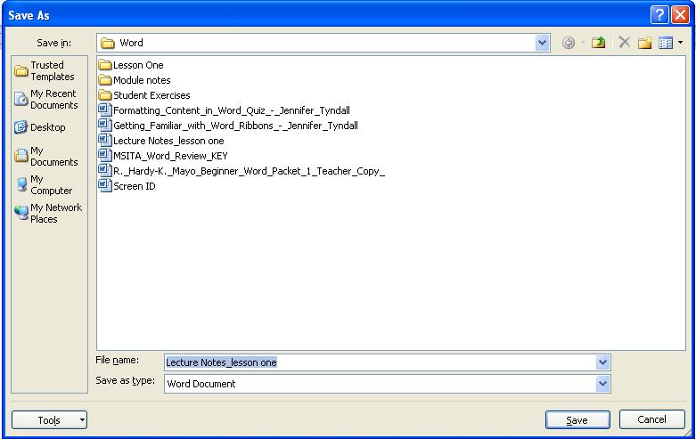
Organizing Files
Users should use Folders to organize their files. This can be done from the Save As dialog box.
The New Folder icon allows the user to create a new folder or subfolder in which to save their document.
The left side of the Save As dialog box allows the user to select drives and locations on their computer.

Slide 33
When to Save
Users should Save their documents often.
Data can be lost if the document is closed without saving.
After saving a document the first time, the Save command will only save the document with the same name in the same location.
The Save As command must be used to (1)change the name of the file or (2)save the document in a new location

Slide 34
Save in More Than One Location
Users should be in the habit of saving their work in more than one location.
Files should be saved:
On the hard drive of the computer (drive C:// or My Documents)
On a the One Drive through your email
On a mobile storage device (ex. Flash drive)
This allows a backup copy of the document in case one of the other locations fails.

Slide 35
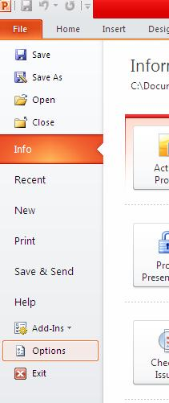
Autosave Feature
Word Autosave/Autorecover features save a document at a set period of time.
These options can be changed to automatically save at shorter intervals from the Backstage under Options.

Slide 36
Autosave
The Options dialog box has a default setting to Auto-recover the document being worked on every 10 minutes.
The user can specify the folder in which to save the auto recovered document
The user can set the options to Auto-save the document if MS Word is exited without saving.
Word will Auto-save in the same place the auto recovered file is stored.

Slide 37
Shortcuts for Saving
The shortcuts for saving a document include:
CTRL + S
SHIFT + F12

Slide 38
Closing Word
There are several ways to close MS Word after saving your document including
Clicking File/Close from the Backstage
Clicking the X in the right-most portion of the Title Bar
Using the shortcut for closing: ALT + F4

